Slide 1
DESIGNING THE ARCHITECTURE OF THE SYSTEM
<<Bus Management Application>>

Slide 2
List of members
01
03
02
04
05
Nde Dilan
Noah Frederic
Madick Cesar
Yann
Joshua

Slide 3
What’s the project's goals and objectives?
01
Designing an application always start with settting goals and objectives:
The goal of the project is to design and develop software for managing the bus service at our university.
To accomplish this goal, we have a set of objectives. Initially, we aim to create a comprehensive service subscription system for students, allowing them to easily enroll in the bus service through their preferred channels, such as online payment or cash. As a secondary goal, we intend to enable students and the university to effortlessly locate and track the bus in real-time using the software.

Slide 4
Identifying the tasks and activities that need to be completed oin order to complete project’s objectives?
02
To complete those two objectives, we divided them into 05 tasks for the first objective which was < Establish a Complete Service Subscription System for Students > and 07 tasks for the second one which was <Enable Real-Time Localization and Tracking of the Bus>.

Slide 5
< Establish a Complete Service Subscription System for Students >
Stages |  | Week 1 | Week 2 | Week 3 | Week 4
1 | December
2 | December
3 | January
4 | January
Design User Interface for Subscription
Develop Online Payment System
Implement Subscription Record Management System
…

Slide 6
<Enable Real-Time Localization and Tracking of the Bus>.
Stages |  | Week 1 | Week 2 | Week 3 | Week 4
1 | December
2 | December
3 | December
4 | January
Develop Bus Information Management System
Create Driver and Conductor Information System
Implement Real-Time Bus Tracking System
…

Slide 7
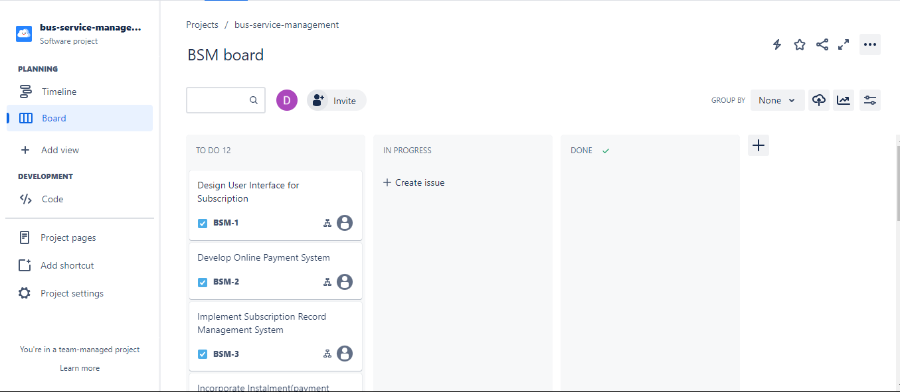
Creating a schedule for the tasks and activities.
03
Every project need a schedule, it’s why our team used the Jira software and its tools to create our own schedule.
Bus Management System Jira Workspace

Slide 8
Estimating the time and resources needed to complete the project
04
To estimate the time and resources needed to complete our project, we used a PERT and a GANT chart.
Next Slide to see it

Slide 9
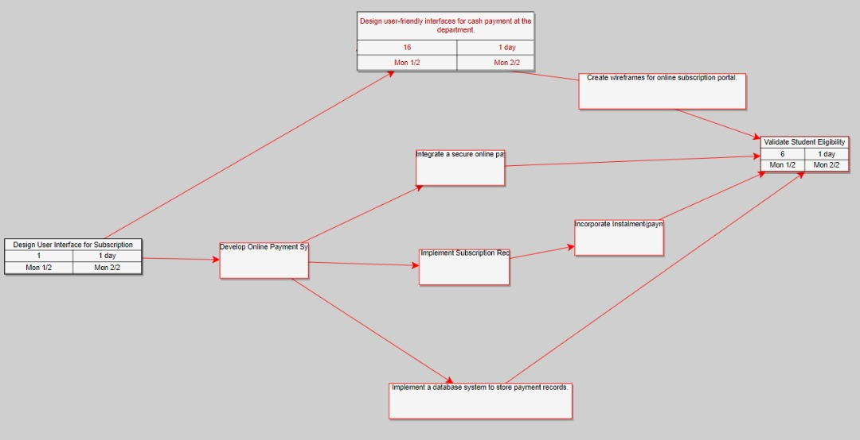
PERT Chart
04

Slide 10
GANT Chart
04

Slide 11
List of resources
The following is the list of our needed resources
Name | Description | Unit Price | Quantity | Total Price
Computers | 4Gb at least and 2,31Hz | 200000 | 20 | 4000000
Modem | 4G Network , High Speed | 20000 | 10 | 200000
Scanners | High Quality resolution | 45000 | 15 | 675000
Chairs | Good quality office chairs | 150000 | 19 | 2850000
Cables | 100 meters long each | 50000 | 10 | 500000
Total | ---------------------------------- | 465000 | 74 | 34410000
So the budget of our project is estimated to 34,410,000 FCFA

Slide 12
End!
Thanks for your kind attention.

